Slide 1

The Vegan Diet
By: Jake Fortner

Slide 2
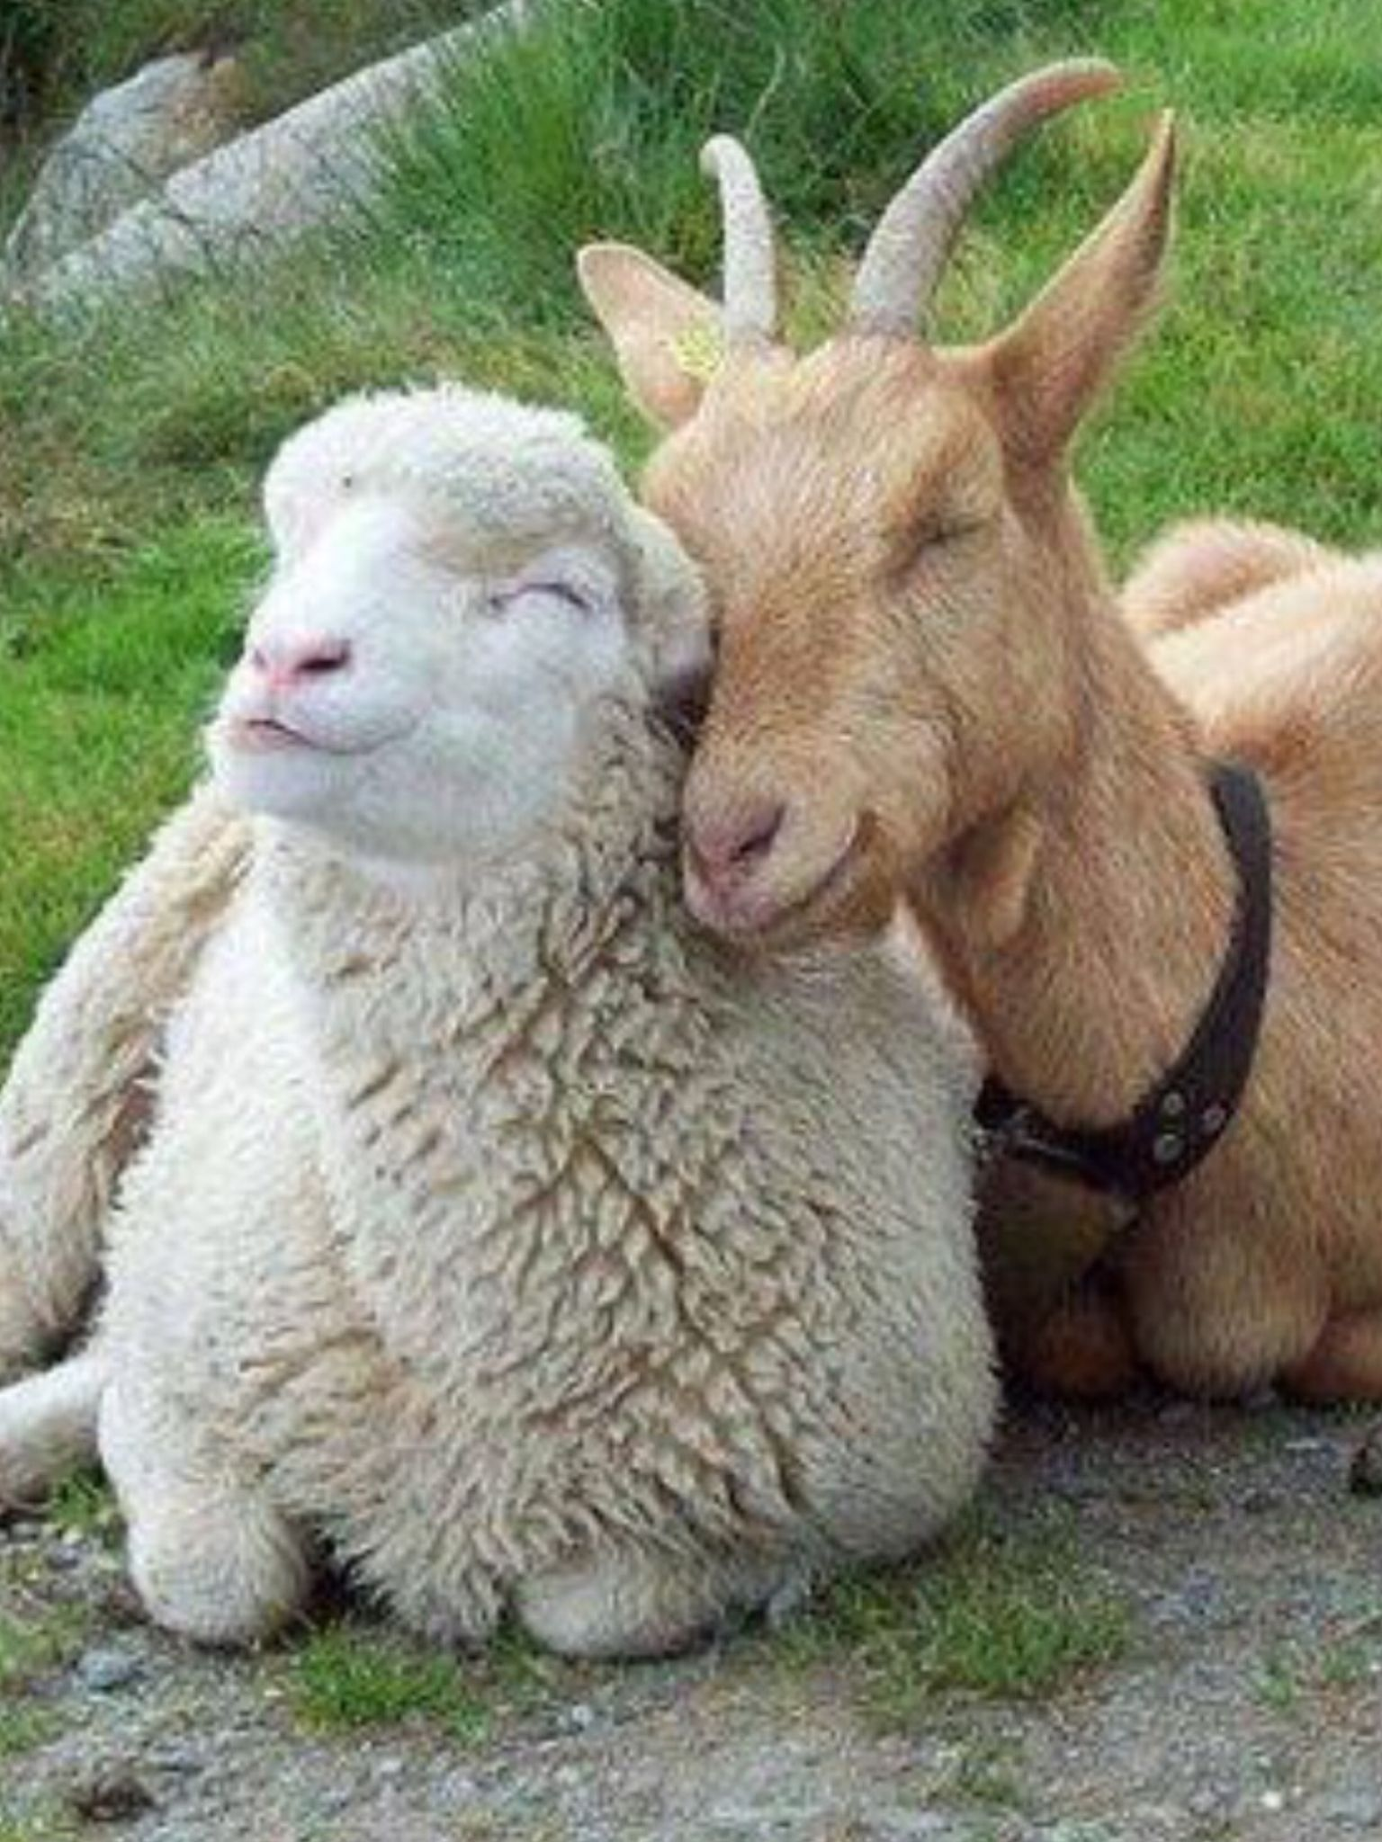
Animals
Save the animals
Reduce animal cruelty and brutality
  Cage holding
  Stressed living conditions
  Separated families

Slide 3

Health Benefits
A diet low in fat, with no cholesterol, and rich in fiber leads to…
Decreases
  Heart Disease
  Cardiometabolic disease
    Type II diabetes
    NAFLD
  Cancer
Increases
  Weight loss
  Energy
  Longevity

Slide 4
Carbon Footprint
A single 1/3lb. of meat requires 660 gallons of water to produce (Sun Basket)
Plant-based crops require 100-200% less water than livestock (Global Citizen)
Passed gas from cows produce methane, which is bad for the atmosphere
Vegan diet preserve water:
For crops to feed livestock
For the livestock themselves
Processing (cleaning/mixing)

Slide 5
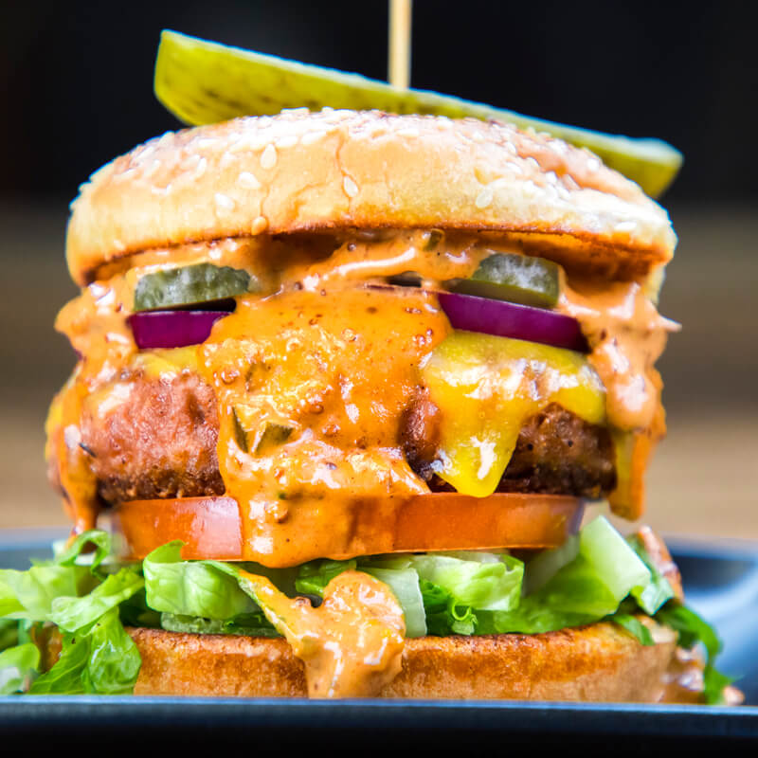
Beyond Meat/Gardein
Beef/Chorizo Crumbles
Burgers
Sausage
Turkey Cutlets
Beef Tips
Fish Sticks
Shrimp
Crab Cakes
Crispy Tenders
Chick’n Patties
Tuna-less salad
Egg-less salad
Taquitos
… AND MORE!

Slide 6
Accidently Vegan
Oreo’s
Pop Tarts
Jell-O
Most Sugar Based Candies (Sour Patch, Air Heads, Etc.)
Fritos
Doritos (Spicy Sweet Chili and Blazin’)
Pringles
Ritz Crackers
Wheat Thins
Nature Valley Crunch Bars
Potato based sides (Hash Brown, French Fries, Tater Tots, Etc.)
Cliff Bars
Nutter Butter
Chocolate (60% cacao or more)
Duncan Hines (Frosting and Cake Mixes)
Bac-O’s (Bacon Bits)
Snyder's Pretzels (excluding onion and honey mustard)

Slide 7
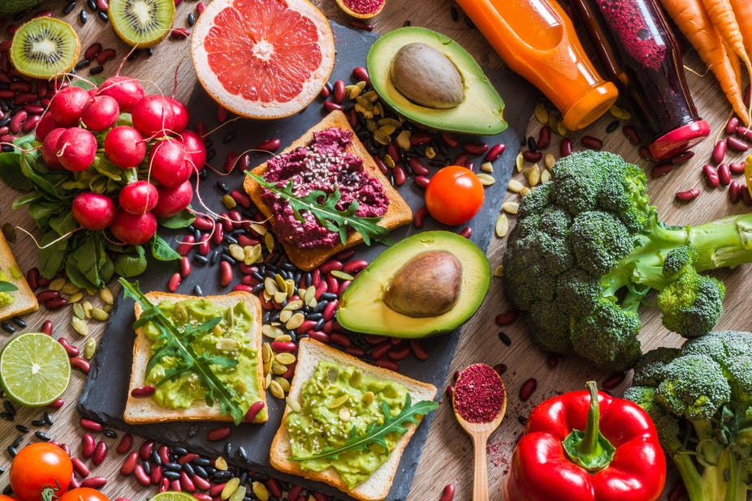
Restaurants
Guilins
Red Robin / Cheesecake Factory: Beyond Burger
Zemam’s
Yard House
Bentley’s House of Coffee and Tea
Welcome Diner (four specials, one every Thursday)
Golden House
MOD pizza
Ghandi Cuisine of India
Chipotle
Med cuisine
Cashew Cow
Lovin’ Spoonful’s
Karuna’s
Burger King
Carl’s Jr.
Del Taco
EAT FRESH
BUY LOCAL

Slide 8
“If you can’t watch your food being made, maybe you shouldn’t eat it.”
- Unknown

